Slide 1
CS 4310: Software Engineering
Lecture 20
Software Maintenance

Slide 2
Software Change
Software change is inevitable:
  New requirements emerge when the software is used
  The business environment changes
  Errors must be repaired
  New equipment must be accommodated
  The performance or reliability may have to be improved

Slide 3
Software Change Strategies
Software Maintenance
  Changes are made in response to changed requirements but the fundamental software structure is stable
Architectural Transformation
  The architecture of the system is modified generally from a centralized architecture to a distributed architecture
Software Re-Engineering
  No new functionality is added to the system but it is restructured and reorganized to facilitate future changes
These strategies may be applied separately or together

Slide 4
Software Maintenance
Modifying a program after it has been put into
use
Maintenance does not normally involve major changes to the system’s architecture
Changes are implemented by modifying existing components and adding new components to the system

Slide 5
Definitions of Maintenance
The performance of the activities required to keep a system operational and responsive after it is accepted and placed into production
Covers the life of a software system from the time it is installed to the time it is phased out
Modification of a software product after delivery to correct faults to improve performance or other attributes
Modification to code and associated documentation due to a problem or the need for improvement.

Slide 6
Why Maintenance?
Software maintenance represents 67- 80 % of the total software costs
Maintenance activities are divided into four classes:
    Adaptive – changes in the software environment
    Perfective – new user requirements
    Corrective – fixing errors (21% of all changes)
    Preventive – prevent problems in the future.

Slide 7
Maintenance costs
Usually greater than development costs (2* to 100* depending on the application)
Affected by both technical and non-technical
factors
Increases as software is maintained. Maintenance corrupts the software structure so makes further maintenance more difficult.
Ageing software can have high support costs
(e.g. old languages, compilers etc.)

Slide 8
Difficulties
It is often difficult to:
Trace changes in code through various versions
Read someone else’s code
Understand a system without documentation
Change code without a modification strategy
Maintain code where design documentation or requirements are missing
Get people to do it properly!

Slide 9
Maintenance Tasks
Think of an industrial project where there are many
developers and testers. Developer A wants to make a
change and Tester B notes a fault.
A simple model would be to have a maintenance
manager who assesses and schedules changes.
All staff should raise maintenance requests
which activate a mini maintenance life-cycle.

Slide 10
Maintenance Categories
Maintenance can be corrective, adaptive, perfective or
preventative.
Corrective : fix a problem
Adaptive : a change to environment
Perfective : improve or enhance the system
Preventative : protect against failures Why categorise?

Slide 11
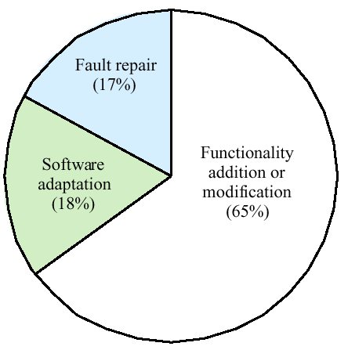
Distribution of Maintenance Effort

Slide 12
Maintenance Process
Process Implementation – planning for configuration management
Problem and Modification Analysis – verification, analysis, alternate solutions, documentation, approval
Modification Implementation – tasking, testing
Maintenance Review and Acceptance – review, accept
Migration and Software Retirement – retirement plan, notification of intent, parallel operations, archive

Slide 13
Regression Testing
After any code changes the (partial) system should be retested with test cases that were used originally as well as any new ones.
Old tests show whether changes have been made and that separate functionality is not affected.
New tests are needed to demonstrate that changes have been made.

Slide 14
How to Regression Test
Look at functionality or requirements to test cases matrix and determine those modules affected by change. Re-run all the appropriate test cases.
This requires traceability of requirements to tests. It also may require a design modules to test case matrix.

Slide 15
Maintenance is Inevitable
The system requirements are likely to change
while the system is being developed because
the environment is changing. Therefore a
delivered system won't meet its requirements!
Systems are tightly coupled with their environment. When a system is installed in an environment it changes that environment and therefore changes the system requirements.
Systems MUST be maintained therefore if they
are to remain useful in an environment

Slide 16
Evolutionary Software
Rather than think of separate development and maintenance phases, evolutionary software is software that is designed so that it can continuously evolve throughout its lifetime

Slide 17
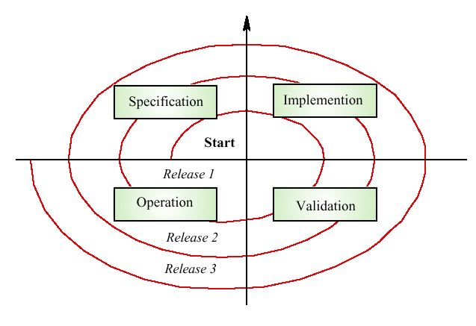
Spiral Maintenance Model

Slide 18
Problems of Waterfall
Requirements volatility
    Requirements may change during development by 30% or more
    This is the direct result of the team’s learning process
Maintenance phase is not uniform
    Frequency of the changes in long lived systems peaks, then declines

Slide 19
Extending Waterfall
If changes can be anticipated at design time
  They can be built in by a parameterization, encapsulations, etc.
  Waterfall model still can be used
However experience confirms:
  Many changes cannot be anticipated by the original designers
  Inability to change software quickly and reliably means that business opportunities are lost

Slide 20
Current Situation
New developments (last couple of years)
  staged model of software lifecycle
  agile software methodologies
    Extreme Programming
    Grass root programmer rebellion
Waterfall still exists
  still a standard
  software engineering textbooks still based on it
  many managers still adhere to it
  rarely followed by the programmers

Slide 21
Staged Model
Initial development
first running version
evolution changes
Evolution
loss of
evolvability
servicing patches
Servicing
servicing discontinued
Phase-out
Switch-off
Close-down

Slide 22
Challenges for Initial Development
To build evolvable software
  evolvable software can handle unanticipated changes
  cost of change is proportional to the size of change
    not to the size of software
To preserve knowledge of the program domain and architecture
  the knowledge is required for evolution

Slide 23
Evolution
Adapts the application to the ever-changing user and operating environment
Corrects the faults
Responds to both developer and user learning
Program grows during evolution
Both software architecture and software team knowledge make evolution possible

Slide 24
Code Decay
Positive feedback between
  the loss of software architecture coherence
  the loss of the software knowledge
    less coherent architecture requires more extensive knowledge
    if the knowledge is lost, the changes will lead to a faster deterioration
Loss of key personnel = loss of knowledge
Challenge: eliminate or slow code decay

Slide 25
Servicing
The program is no longer evolvable
  it either decays or managers decide not to support evolution
Changes are limited to patches and wrappers
  less costly, but they cause further deterioration
Process is very different from evolution
  no need for senior engineers
  programmer is assigned only part of the software to support
  the process is stable

Slide 26
Challenges in Servicing
Making the change without unexpected additional effects
Program comprehension
Documentation management
Delivery of service patches
  upgrading software without the need to halt it

Slide 27
Phase-out
No more servicing is being undertaken
  but the system still may be in production
The users must work around known deficiencies

Slide 28
Close-down
The software use is disconnected
  current life of successful software: ~ 15 years
The users are directed towards a replacement.
Business issues:
  Can any of the software be re-used?
  “Exit strategy” is needed.
    changing to another system is expensive
    what to do with long-lived data?

Slide 29
Versioned Staged Model
Initial development
first running version
evolution changes
Evolution Version 1
servicing patches
Servicing Version 1
evolution of new version
evolution changes
Phase-out Version 1
Evolution Version 2
servicing patches
Close-down Version 1
Servicing Version 2
evolution of new version
Phase-out Version 2
Evolution Version . . .
Close-down Version 2

Slide 30
Process Metrics
Process measurements may be used to assess maintainability
  Number of requests for corrective maintenance
  Average time required for impact analysis
  Average time taken to implement a change request
  Number of outstanding change requests
If any or all of these is increasing, this may indicate a decline in maintainability

Slide 31
Architectural Evolution
There is a need to convert many legacy systems from a centralized architecture to a client-server architecture
Change drivers
  Hardware costs. Servers are cheaper than mainframes
  User interface expectations. Users expect graphical user interfaces
  Distributed access to systems. Users wish to access the system from different, geographically separated, computers

Slide 32
Key Points
Software change strategies include software maintenance, architectural evolution and software re-engineering
Maintenance types are
  Maintenance for repair
  Maintenance for a new operating environment
  Maintenance to implement new requirements

Slide 33
Key Points
The costs of software change usually exceed the costs of software development
Factors influencing maintenance costs include staff stability, the nature of the development contract, skill shortages and degraded system structure
Architectural evolution is concerned with evolving centralized to distributed architectures

Slide 34
Project Work
Continue working on your design Document
Continue working on your prototype
Team presentations will be during weeks nine and ten – coming up soon!

